Slide 1

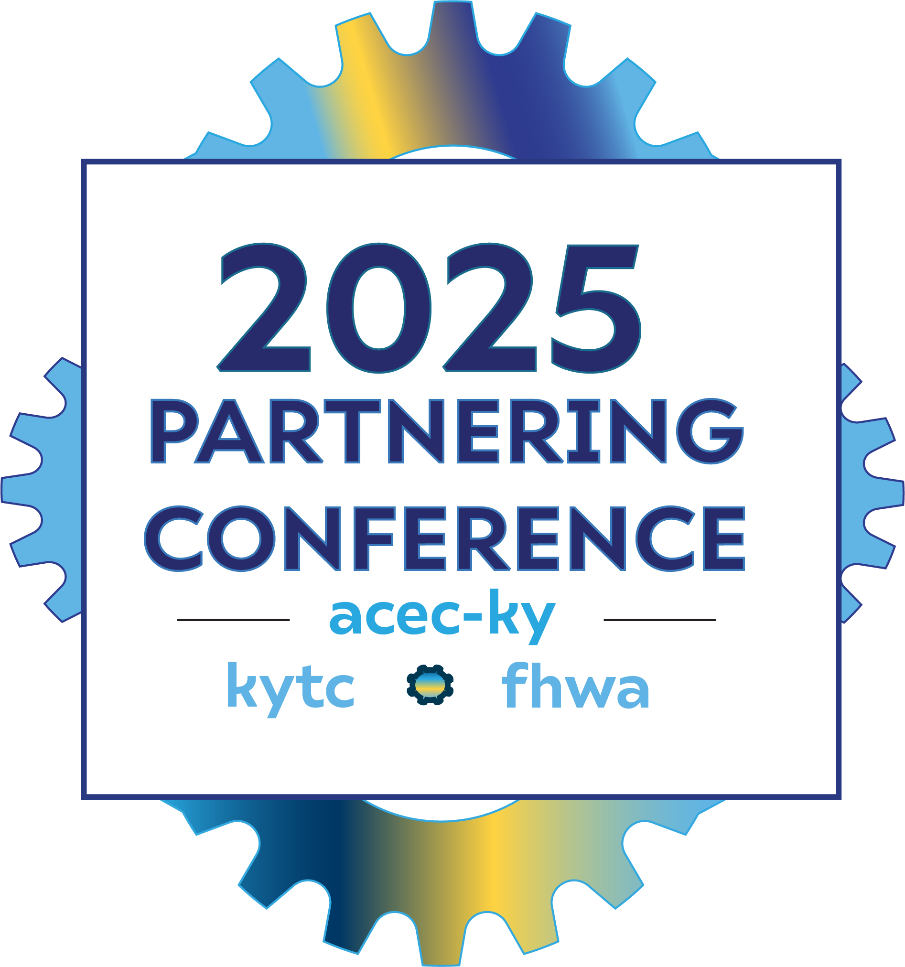

Kentucky
EV Charging
Program Update
September 4, 2025
Notes:
Speakers: Mikael, Kathryn, Ben, Casey

Slide 2




Presenter Team
Mikael Pelfrey
Director, Division of Planning
EV Charging Program Deputy Project Manager
KYTC
Kathryn Roos
Principal Strategic Consultant
EV Charging Program
Policy
Consultant Team
HDR
Ben Saylor
Project Coordinator
EV Charging Program
Inspection
Consultant Team
HDR
Casey Moll
Site Inspection Lead
EV Charging Program Inspection
Consultant Team
WSP
Notes:
Mikael

Slide 3

Agenda
Program Update
Program Challenges
Developer Management
Construction Inspection
Next Steps
Notes:
Mikael

Slide 4
Program Update
Notes:
Mikael

Slide 5
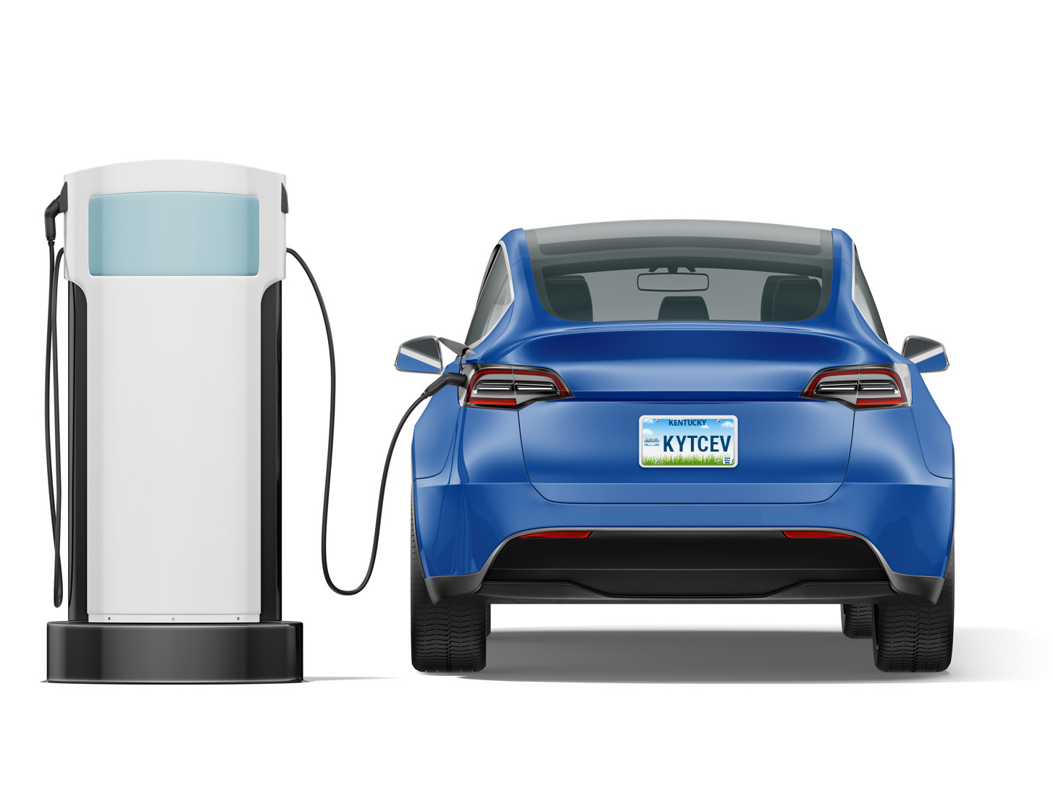
Building a National Charging Network
NEVI is the National Electric Vehicle Infrastructure Formula Program
Established through the Bipartisan Infrastructure Law (BIL)
Funding to states to strategically deploy charging stations
Goal is to build an interconnected network
Kentucky expected to receive nearly $70 million over five years
Notes:
Mikael:

Slide 6
Kentucky’s EV Plan Vision
A reliable, accessible, convenient, and affordable EV charging network that supports transportation choices, energy diversification, economic development, and environmental sustainability for all Kentuckians.
Notes:
Mikael:

Slide 7
Kentucky’s EV Plan Goals
A corridor-based EV charging system that supports interstate and regional travel
GOAL 1
GOAL 2
A local EV ecosystem that serves Kentucky’s communities and travelers
GOAL 3
A comprehensive system that supports transportation choices for all of Kentucky’s residents
GOAL 4
An interconnected, reliable, and resilient vehicle fueling system that can adapt to changes in market conditions and transportation technologies
GOAL 5
A transportation system that reduces tailpipe emissions and promotes clean air in Kentucky
Notes:
Mikael:

Slide 8




NEVI Funded Fast Charging Stations
KYTC will not own, operate, or maintain stations
Stations will be located on private property
Industry partners (private sector) will be responsible for:
Construction/
Installation
Ownership
Operations
Maintenance
Notes:
Mikael:

Slide 9
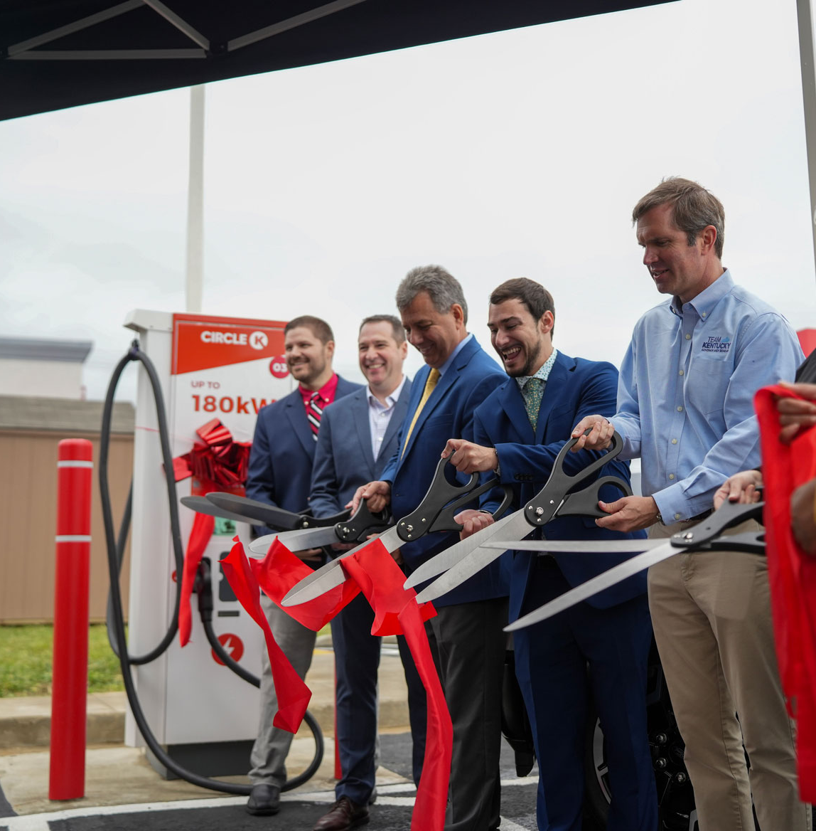
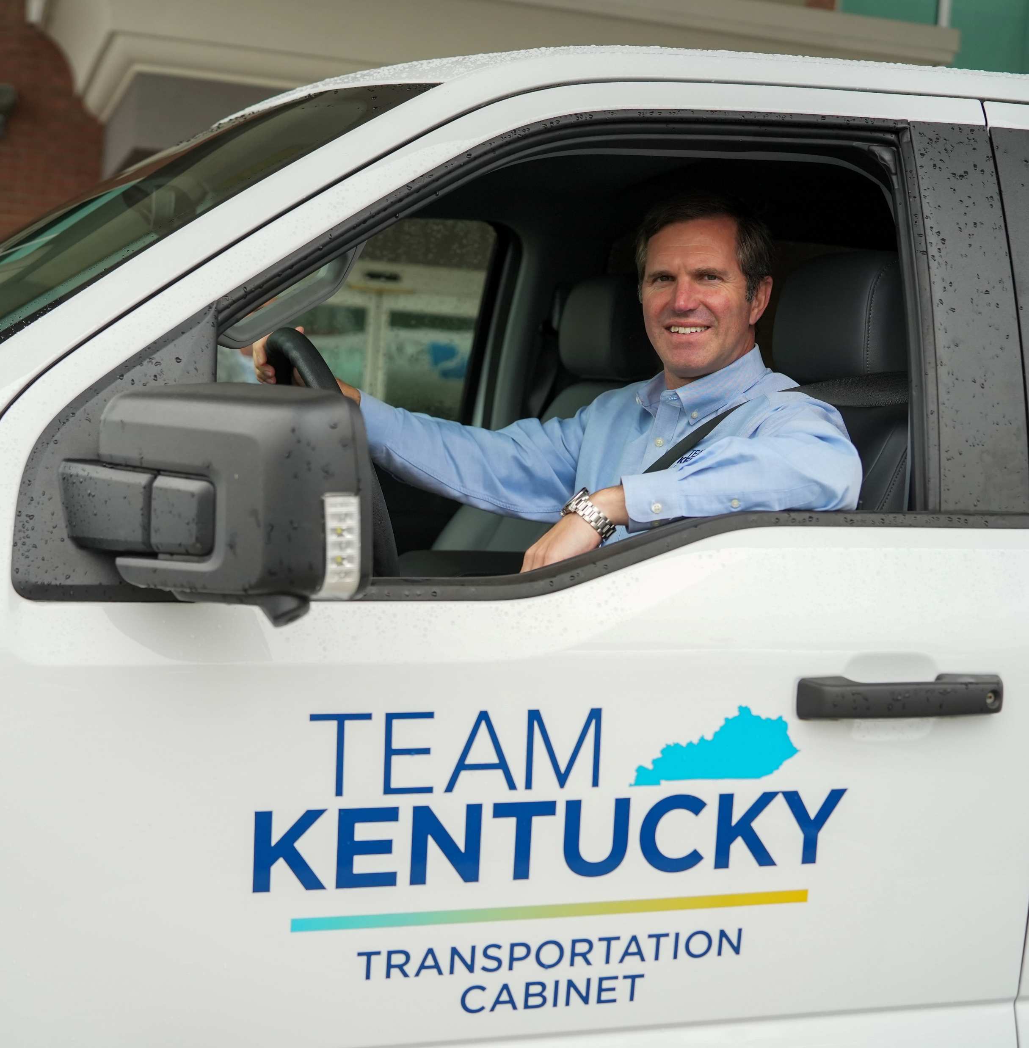
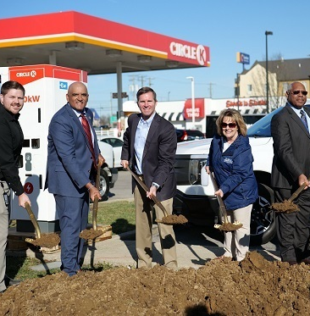
Kentucky Leading the Charge
46 fast charging stations from 11 developers have been approved in Kentucky.
$36.9 million in federal formula funds obligated for Kentucky to date. KY expects nearly $70 million in total from NEVI.
First NEVI funded station to open in the southeast.
Notes:
Mikael: NEVI Program Update

Slide 10
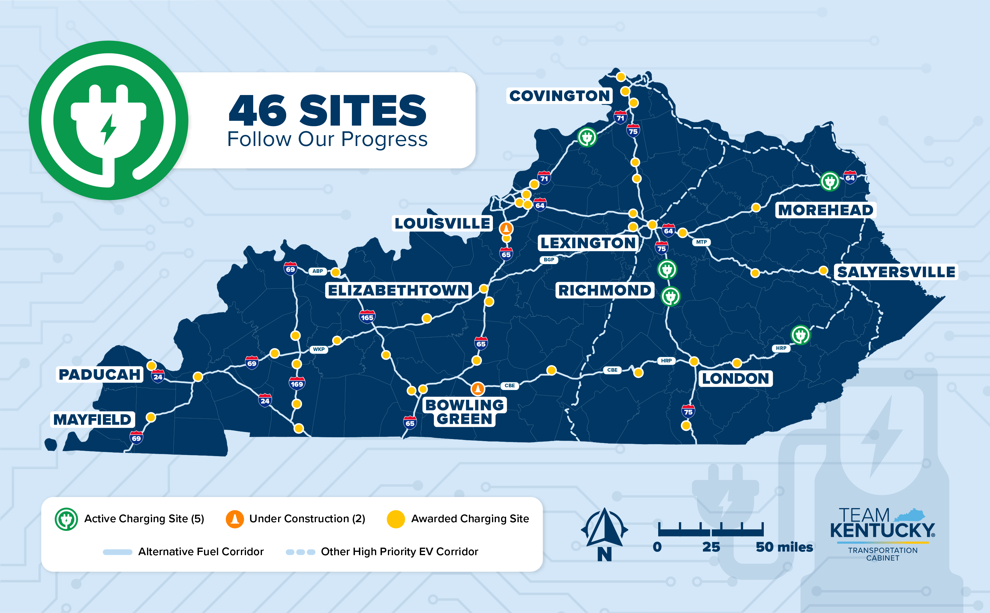
Notes:
Mikael: NEVI Program Update-

Slide 11
Major NEVI Program Updates in 2025
Executive Order 14096 - Unleashing American Energy
February 6th Letter from FHWA: Suspending Approval of State Electric Vehicle Infrastructure Deployment Plans
  Froze NEVI funding
August 11th Updated NEVI Guidance
  Plan to be submitted in September to access remaining funds
Notes:
Mikael:
Funding freeze
Latest guidance- released in August
How do we plan for uncertainty/resiliency

Slide 12
Program Challenges
Notes:
Kathryn (Below is from notes on kick off call)
How fed gov has set this up
Developers working with gov agencies
Challenges w/ developer buildout
Site host issues
Developer issues
Rules and regulations

Slide 13
Program Challenges
  NEVI Requirements and Other Regulations
    Meeting federal requirements takes a lot of effort
  Building Developer Familiarity
    Building knowledge and familiarity with federal program requirements is a process.
  Project Roadblocks
    Project progress can stall with common developer issues such as site host issues
  Time Commitment
    Managing a NEVI program requires significant time from staff to work with developers.
Notes:
KATHRYN
Overview of program challenges

Slide 14
NEVI Requirements and Other Regulations
Program Challenges
Title/Link | Abbreviation
Title 23 Code of Federal Regulations Part 637 (as applicable) | 23 CFR Part 637
Title 23 Code of Federal Regulations Part 655 / Part 750 (as applicable) | 23 CFR Part 655/750
Title 23 Code of Federal Regulations Part 680 (as applicable) | NEVI
Title 2 Code of Federal Regulations Part 200 (as applicable) | 2 CFR Part 200
The Davis-Bacon Act, as Amended | Davis-Bacon
Required Contract Provisions Federal-Aid Construction Contracts FHWA Form 1273 | FHWA Form 1273
Americans with Disabilities Act of 1990 | ADA
Title VI of the Civil Rights Act of 1964 | Title VI
National Environmental Policy Act of 1969 | NEPA
Build America, Buy America; Buy America Construction Program Guide, including Q&As for Build America, Buy America Implementation Plan to Enhance Buy America for Electric Vehicle (EV) Chargers; 23 USC 313; Build America/Buy America statutory requirements established by the IIJA/BIL; Buy America; OMB-M-24-02 Memo; and 2 CFR 184 (as applicable). | BA and BABA
KYTC Standard Specifications for Road and Bridge Construction Edition of 2019 (as applicable) | KYTC Standard Specifications
2018 Kentucky Building Code (as applicable) | Building Code
National Electric Code, NFPA 70 (as applicable) | NEC
Notes:
Kathryn- NOTE this is not for covering all regulations, instead its meant to highlight how many requirements are included within the KY EV charging program. This is a challenge for both KYTC to oversee compliance for and for developers to meet

Slide 15
Building Developer
Familiarity
Program Challenges
Private developers have limited exposure to working within Federal program regulations
NEVI requirements are rigorous
Developer education
  Developer task worksheets
  Guidance documents and presentations
  Office Hours
Notes:
KATHRYN

Slide 16

Project Roadblocks
Program Challenges
Numerous challenges can impact project progress including:
Site Host drop-outs
Schedule delays
Site revisions
Notes:
KATHRYN

Slide 17
Time Commitment
Program Challenges
Administration requires full time staff and detailed, clear processes to stay organized and compliant
Multi-discipline team of subject matter experts
(e.g., planning, Federal policy, EVSE technology, document control)
Regular meetings with developers to maintain momentum and field questions
Significant investment in document control process
Notes:
KATHRYN
What is our FTE equivalent for this contract? Kate asked Rob
Hand off to Ben

Slide 18
Developer Management
Notes:
BEN
Sharepoint System
Number of deliverables and how we track deliverables/projects
Utilizing existing tech that KYTC uses (Teams/Sharepoint)
Worksheets
Regular Developer Meetings and Office Hours

Slide 19
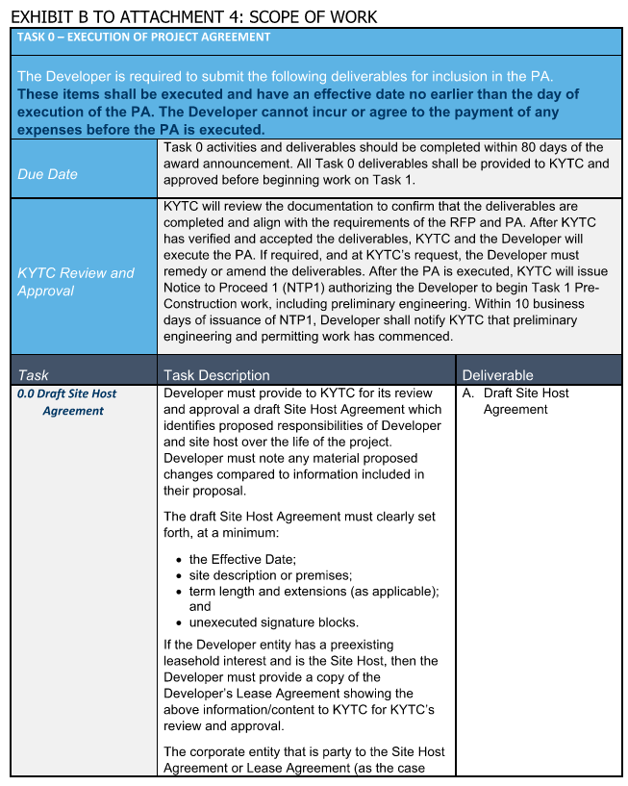
Scope of Work
The KYTC team developed a detailed scope of work for developers to follow
    137+ Documents Required per Site
    x 46 Sites
    = 6300+ Documents
Notes:
BEN
How we manage developer submission and compliance
Design process

Slide 20
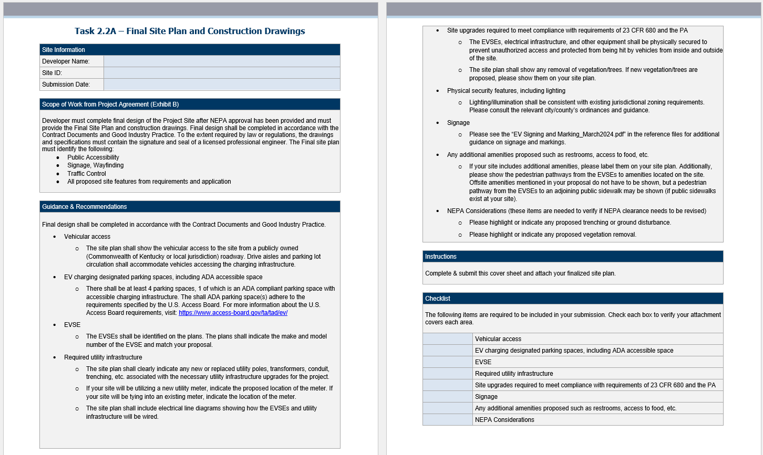
Worksheets
Each deliverable has a worksheet to be completed by the developer and reviewed by KYTC’s team
Notes:
BEN
How we manage developer submission and compliance
Design process

Slide 21


Submission & Tracking
Microsoft SharePoint for all submissions
Microsoft Planner to track all submissions
Developers have access to dashboards showing their progress
Notes:
BEN
How we manage developer submission and compliance
Design process

Slide 22


Regular Meetings
Scheduled one-on-one biweekly meetings with each developer
Utilizing Microsoft Bookings to let developers schedule “Office Hour” appointments with the team
Notes:
BEN
Hand off to Casey

Slide 23
Construction Inspection

Slide 24
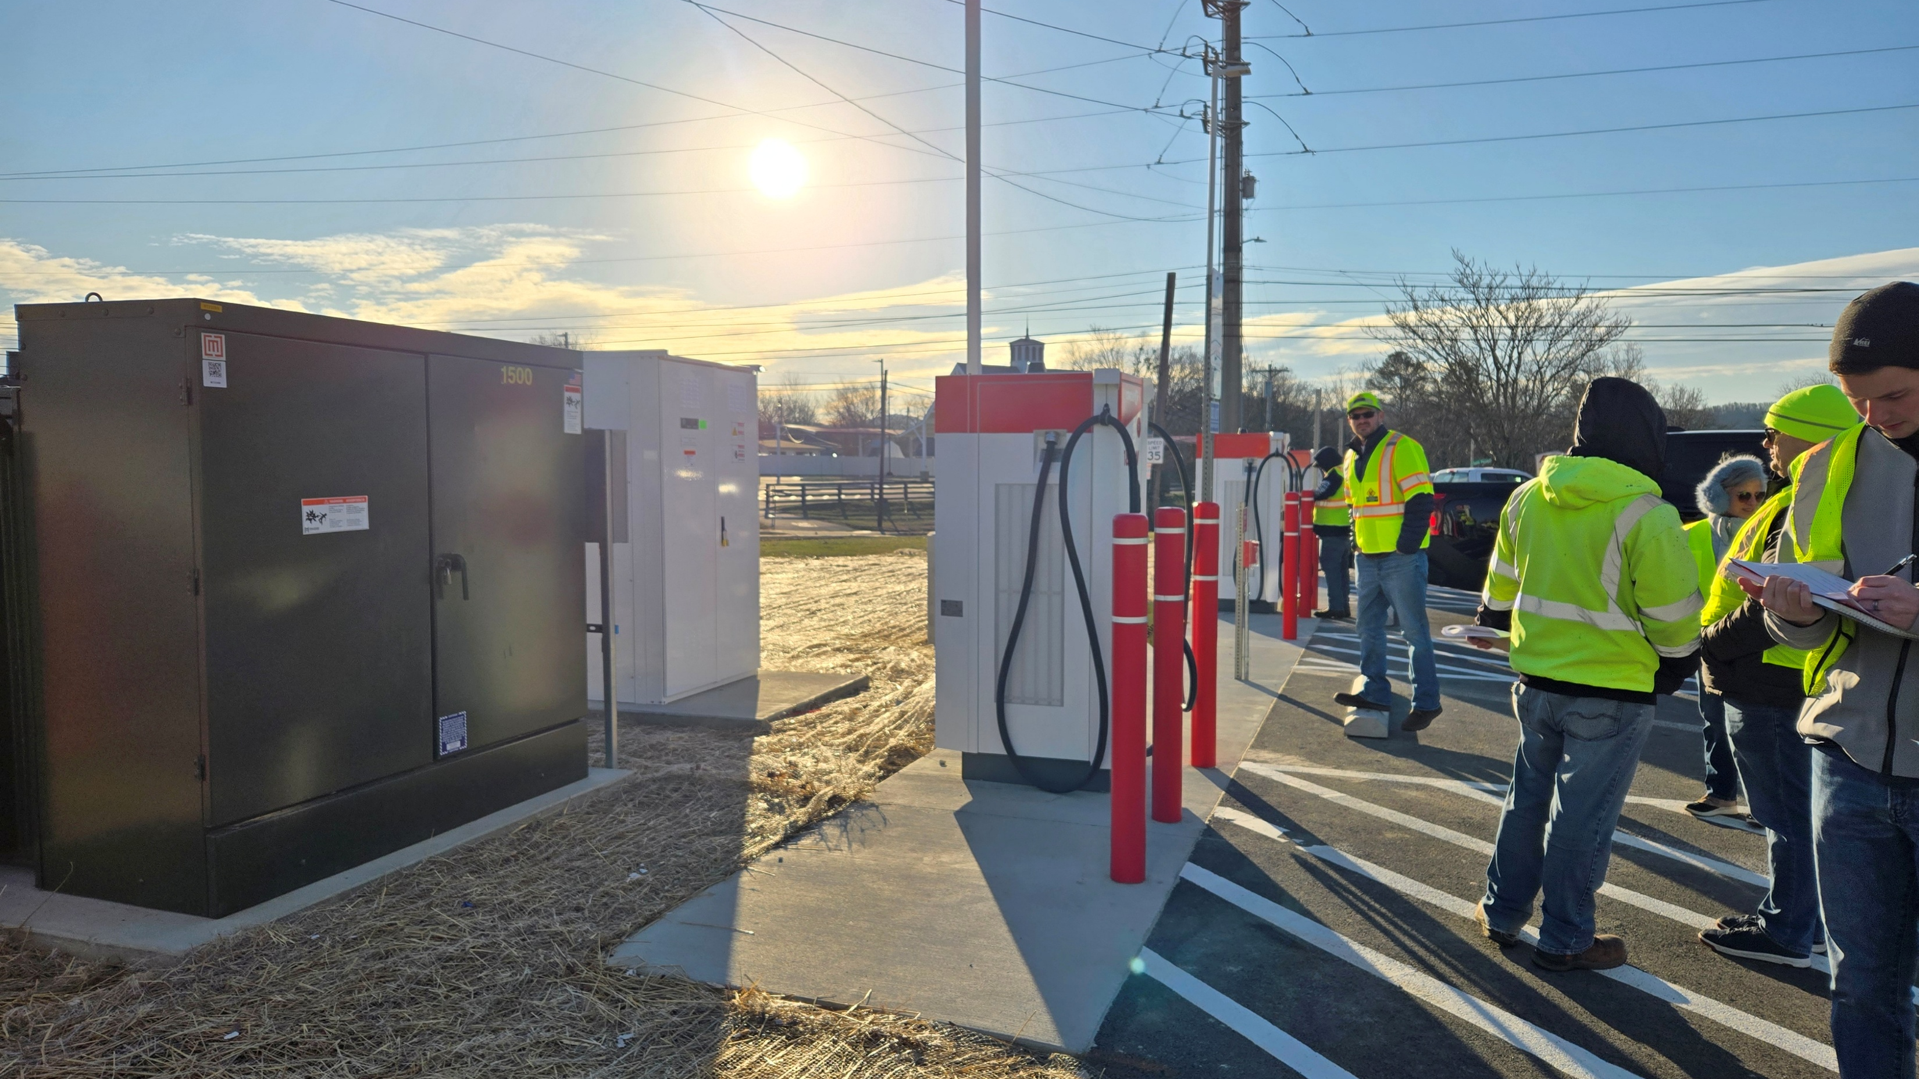
Our Role
Notes:
Casey- Speak to our role on inspection including which events we are present for and what we do at those visits

Slide 25
Construction Inspection
Inspection Challenges
Changes to the site plans without appropriate reviews
Typical field construction specs were not required based on NEVI rules
Communications for on-site work schedule needed improvement
Plans lack certain dimensions and/or standard detail diagrams for work
Notes:
Casey
How its playing out in the field- what are the challenges

Slide 26

Construction Inspection
Inspection Solutions
Inspection check list
  State-level requirements
  NEVI program-level requirements
  Federal-level requirements
Dedicated KYTC team point of contact for in the field
Notes:
Casey
Solutions-
Cover the inspection check list
Highlight how the KYTC/consultant team has a dedicated site inspection point of contact for the field – so developers can reach out directly

Slide 27
Next Steps
Notes:
MIKAEL
Give a brief overview of where the program is headed next if remaining funds are accessible. Cover the 3 phases: AFC Network, Other Priority Corridors, Community Charging

Slide 28
Notes:
Mikael:
Phase 1: AFC Network: KYTC is currently assessing the 46 planned and operational stations along its AFCs to determine whether the AFC network will be sufficiently served with charging stations and could qualify for Build Out Certification.

Slide 29

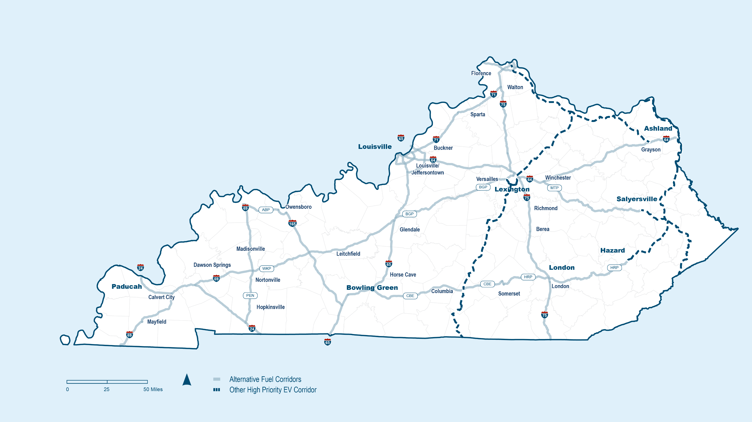
Next Steps- Other Priority Corridors
AA Hwy / KY 9
US 68
US 27
US 127
US 23
KY 80
Mtn Pkwy Extension
Alternative Fuel Corridors
N
Other High Priority EV Corridors
Notes:
MIKAEL
Phase 2- Other Priority Corridors-
*still in development
WE are identifying the major corridors beyond our AFCs to provide charging along other high demand, well-traveled roadways

Slide 30









Next Steps- Community Charging
Workplaces | Retail and Commercial Centers | Multifamily Housing
Parks & Nature Centers | Fueling Stations | Hotels and Lodging
Public Institutions (libraries, gov’t buildings) | Tourism Destinations | Downtown Centers
Notes:
MIKAEL
Phase 3 (runs concurrently with Phase 2)- community charging locations that could bring public charging locations to communities and fill existing charging gaps

Slide 31
Questions?
Notes:
Mikael: Open the floor to questions for the group

